Slide 1


Individual Insolvency in India : An Overview
Historical Context : The genesis of Insolvency Laws
The Rationale Behind Two Separate Acts
Ambiguity : Enactment of IBC
Clarification from the Ministry of Finance
Current Scenario : Co-existence of IBC, PTIA 1909 & PIA, 1920
Applicability of the PIA, 1920
The Statutory Process of Insolvency under PIA, 1920
The Statutory Process of Insolvency under IBC, 2016
Priority of Debts: A Waterfall Mechanism under PIA, 1920
Priority of Debts: A Waterfall Mechanism under IBC, 2016
Appeals and Appellate Jurisdiction
FAQs

Slide 2

Historical Context: The Genesis of Insolvency Laws
The Presidency Towns Insolvency Act, 1909 (PTIA, 1909)
The Provincial Insolvency Act, 1920 (PIA, 1920)
The act streamlined insolvency procedures for individuals outside the Presidency Towns.
The District Courts have jurisdiction under this Act.
Threshold amount : 500 Rupees
The administrative officer is called as “Official Receiver”.
The act consolidated and amended insolvency laws for individuals and partnerships in Calcutta, Madras, and Bombay.
The High Court of each Presidency town has exclusive jurisdiction under this Act
Threshold amount : 500 Rupees
The administrative officer is called as “Official Assignee”

Slide 3

The Rationale Behind Two Separate Acts
Differing Socio-Economic Conditions
Tailored Provisions
The existence of two separate insolvency laws in British India was due to the differing socio-economic and commercial conditions between the Presidency towns and the mofussil.
The complex commercial environment of large cities required tailored provisions, which were considered impractical to address within a single unified statute.
Similar Objectives, Different Applicability
Both the PTIA, 1909 and the PIA, 1920 shared the objective of addressing individual insolvency, but differed in their applicability.

Slide 4



Ambiguity : Enactment of IBC
Ambiguity
Repeals u/s 243, IBC
Section 243, titled "Repeal of Certain Enactments and Savings," contemplates the repeal of the Presidency Towns Insolvency Act 1909, and the Provincial Insolvency Act, 1920. However, this provision remains unenforced to date.
Multiple Writs were filed across various High Courts concerning individual insolvency, leading to uncertainty and confusion regarding the appropriate forum for such matters.
The Insolvency and Bankruptcy Code came into force on May 28, 2016, but introduced ambiguity due to the partial enforcement of Part III.
While the provisions for personal guarantors to corporate debtors were notified, the sections concerning individuals, proprietorships, and partnership firms remain unenforced.

Slide 5

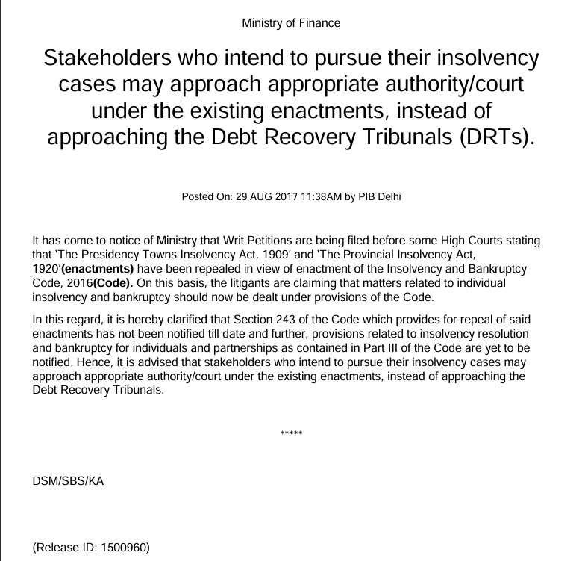
Clarification from Ministry of Finance : Resolving Ambiguities
The Ministry of Finance, through a press release dated August 29, 2017, clarified that as Section 243 of the IBC which provides for repeal of said enactments has not been notified till date & until the relevant provisions of the IBC pertaining to the insolvency of the Individuals come into force, the Presidency Towns Insolvency Act, 1909, and the Provincial Insolvency Act, 1920 shall remain in effect.

Slide 6

Current Scenario : Co-existence of IBC, PTIA 1909 & PIA, 1920
1
Corporate Insolvency & Individual Insolvency
The IBC serves as the comprehensive legislation for insolvency and bankruptcy proceedings concerning companies and limited liability partnerships (LLPs).
The PIA,1920 & PTIA, 1909 continue to govern insolvency proceedings for individuals particularly in cases unrelated to corporate debtors.
With the partial notification of Part III, the IBC now also addresses the insolvency of personal guarantors to corporate debtors.
2
Adjudicating Authority
The National Company Law Tribunal acts as the adjudicating authority for the corporate debtors and personal guarantors to corporate debtors.
The District Courts and the courts subordinate to District Courts retain jurisdiction over individual insolvency matters under the PIA 1920 & PTIA 1909
3
Procedural Law
IBC prescribes specific procedures for insolvency proceedings under the Code
The Code of Civil Procedure governs the procedural aspects of insolvency proceedings under the PIA 1920 & PTIA, 1909

Slide 7

Applicability of the PIA, 1920
Bar on Insolvency Petitions against certain entities u/s 8
No insolvency petition shall lie or be presented against
Corporations,
Associations, or
Companies registered under any enactment currently in force.
Therefore, the PIA,1920 is applicable only on Individuals.
Jurisdiction for Presentation of Insolvency Petitions u/s 11: An Insolvency Petition shall be filed before a court having jurisdiction
Where the debtor ordinarily resides;
Where the debtor conducts business;
Where the debtor personally works for gain; or
Where the debtor is detained in custody, in the event of arrest or imprisonment.

Slide 8
The Statutory Process of Insolvency under PIA, 1920
Petition u/s 7 of the Act shall be filed by
either the debtor or the creditor.
1
2
Petition Verification in accordance with
Sections 9 and 10, as applicable.
After verification, the Petition shall be
prima facie admitted
3
4
Fixing of Hearing Dates and Issuance of Notices
After Petition Admission u/s 19
Appointment of Interim Receiver and
Interim Orders by Court
5
6
Commencement of Insolvency Proceedings
by Adjudication Order
Treatment of Debtor's Property
Post-Adjudication Order
7
8
Publication of Order in the Official Gazette
Preparation of Schedule of Creditors
9
10
Proposal submitted by Debtor
Order of Approval or Refusal
11

Slide 9
The Statutory Process of Insolvency under IBC, 2016
Petition u/s 7, 9 & 10 as applicable shall be
filed before the adjudicating authority
1
2
Once the application is accepted, an Interim
Resolution Professional is appointed.
The Moratorium commences and a Public
Announcement is made to invite claims.
3
4
The IRP takes control over the business, financial
information, collects claims and constitutes the
Committee of Creditors
The CoC holds its 1st meeting and appoints or
replaces the Resolution Professional. The CoC
works with the RP to finalize the CIRP
5
Resolution Plans are invited by the Prospective
Resolution Applicants
6
The CoC votes and the most suitable Resolution
plan is selected.
7
8
The RP presents the Resolution Plan to the
Adjudicating Authority for approval
If the Adjudicating Authority approves the
Resolution plan, the PRA becomes a
Successful Resolution Applicant and
the CIRP is implemented
9
If the Adjudicating Authority rejects the plan or
the RP does not receive any plan, the Corporate Debtor is adjudicated for Liquidation.
10

Slide 10




Priority of Debts: A Waterfall Mechanism under PIA, 1920
1
Administration Expenses
2*
A. Government/Local Authority Debts
B. Salary & Wages
3
All debts in Schedule of Creditors
*Debts mentioned in Level 2 (Government/local authority debts and wages) are of equal priority and will be paid in full unless the insolvent’s assets are insufficient.

Slide 11
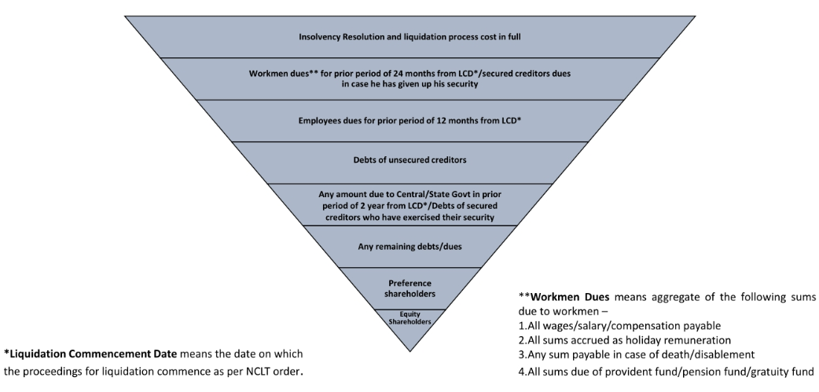
Priority of Debts: A Waterfall Mechanism under IBC , 2016

Slide 12




Appeals and Appellate Jurisdiction
Insolvency & Bankruptcy Code , 2016
Provincial Insolvency Act , 1920
National Company Law Tribunal : Adjudicating Authority
Subordinate Court: Small Causes Court (Filing of First Petition)
National Company Law Appellate Tribunal : an appeal must be filed within 30 days of the order being pronounced. The NCLAT may allow an extension of up to 15 days if there is sufficient cause for the delay.
District Court : Appeal within 30 days
High Court : Appeal within 90 days
Supreme Court: an appeal must be filed within 30 days of the date of receipt of such order. The SC may allow an extension of up to 15 days if there is sufficient cause for the delay.

Slide 13




FAQs
Whether the enactment of the IBC has rendered the Provincial Insolvency Act, 1920, inoperative?
No, the Provincial Insolvency Act, 1920 still remains in force. Part III of the IBC, which governs individual insolvency, has not been fully notified yet. The Ministry of Finance clarified that the Act continues to apply until the relevant provisions of the IBC are brought into force. : State Bank Of India vs V. Ramakrishnan (2018)
What is the Jurisdiction under the Provincial Insolvency Act, 1920?
The proper jurisdiction for an appeal under the Provincial Insolvency Act against orders passed by a Court subordinate to the District Court is the District Court in the first instance : Kosuru Krishna Kishore Babu v Sanaka Subrahmanayam (2024)
The Hon'ble High Court of Madras reiterated that the jurisdiction and applicability of pre-existing insolvency laws remain unchanged for individuals, i.e., District Courts : Rohit Nath v KEB Hana Bank Ltd (2023)
Is a petition under the Provincial Insolvency Act, 1920 maintainable?
Yes, such a petition is maintainable. A petition under Section 7 and 13 of the Act was filed by the petitioner, seeking himself to be adjudicated as an insolvent before the court of Insolvency Judge of Central District at Tis Hazari Courts, Delhi : Shri Surya Paul v M/s Standard Chartered Bank & Ors (2018)

Slide 14
Areness is a full-service law firm offering comprehensive insolvency and banking solutions. We provide expert advice on insolvency, corporate governance, and advisory services, aiming to drive policy improvements for more efficient insolvency proceedings. Our expertise spans advising creditors, corporate debtors, and insolvency professionals on all aspects of insolvency law, conducting due diligence on company affairs, debts, and assets, and guiding resolution applicants on statutory insolvency, pre-packaged insolvency, going concern sales, and liquidation sales.
Connect with us
New Delhi
304, 1/52, North Avenue Road,
Punjabi Bagh West, New Delhi- 110026
5, Sardar Patel Marg, Diplomatic Enclave
Chanakyapuri, New Delhi-110021
Gurugram
301, Tower B, Global Business Park,
MG Road, Gurugram
Created by :
Pallavi Singh
Trainee Associate,
IBC & Banking
Areness Attorneys

